Slide 1
Suicide in the United States
Facts, Figures, and Formulas for Prevention

Slide 2
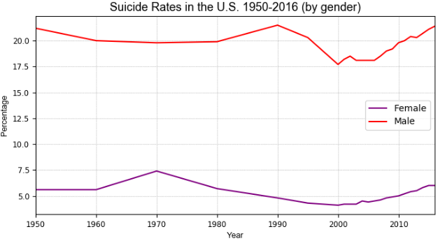
Differences in Suicide Among Men and Women
Source: US Department of Health and Human Services; CDC (September, 2018). Deaths by suicide per 100,000 resident population in the United States from 1950 to 2016, by gender.

Slide 3
Differences in Suicide Among Men and Women
Suicide is the 10th leading cause of death in the United States.
There are a number of gender differences in suicide. This is known as the gender paradox of suicide.
On average, men died by suicide 3.x more often than women.
In 1990 and 2016, men had the highest suicide rates (21.5% and 21.4% per 100,000) among males
In 1970 and 2016, women had the highest suicide rate (7.4% and 6% per 100,000) among females

